Slide 1
NYCU DLP
Lab1 - Backpropagation
2021 Summer
李美慧
July 13, 2021

Slide 2
Outline
Lab Objective
Important Date
Lab Description
Scoring Criteria

Slide 3
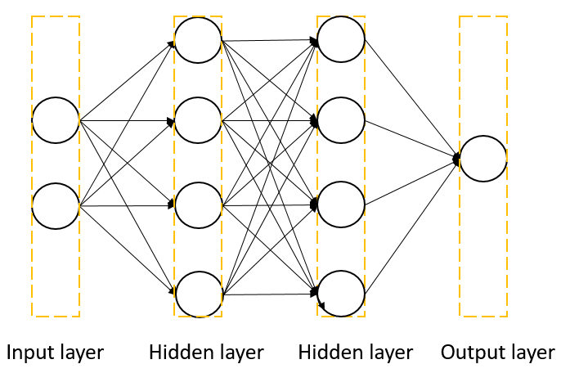
Lab Objective
In this lab, you will need to understand and implement a simple neural network with forward and backward pass using two hidden layers

Slide 4
Important Date
Report Submission Deadline: 7/20 (Tue.) 12:00 p.m.
Demo date: 7/20 (Tue.)
Zip all files into one file
Report (.pdf)
Source code
Name it like「DLP_LAB1_yourstudentID_name.zip」
ex: 「DLP_LAB1_309551027_李美慧.zip」

Slide 5
Lab Description
Implement a simple neural network with two hidden layers
You can only use Numpy and other python standard libraries.
Plot your comparison figure showing the predictions and ground truth.
Plot your learning curve (loss, epoch).
Print the accuracy of your predictions.

Slide 6


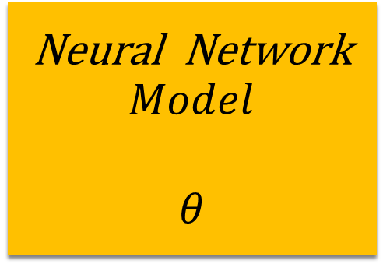









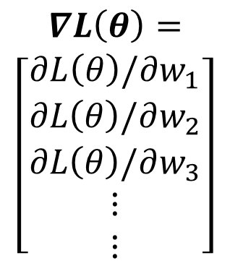

Lab Description
$${ x}^{n}$$
Neural Network
$$Model$$
$$θ$$
$${ \hat{y}}^{n}$$
Loss Function
$${ y}^{n}$$
$$L(θ)$$
Input
Model
Output
Ground
truth
$$∇L\left(θ\right)=$$
$$\left[\begin{aligned}∂L\left(θ\right)/∂w_{1} \\ ∂L\left(θ\right)/∂w_{2} \\ ∂L\left(θ\right)/∂w_{3} \\ ⋮ \\ ⋮\end{aligned}\right]$$
$${Compute ∇L(θ}^{0})$$
$$θ^{1}={θ^{0} − ρ ∇L(θ}^{0})$$
$$θ=\{w_{1},w_{2},w_{3},w_{4},⋯\}$$
$${Compute ∇L(θ}^{1})$$
$$θ^{2}={θ^{1} − ρ ∇L(θ}^{1})$$
$${Compute ∇L(θ}^{2})$$
$$θ^{3}={θ^{2} − ρ ∇L(θ}^{2})$$
$$ρ :Learning rate$$

Slide 7
Lab Description – Flowchart
Prepare data
Create model
Forward pass
Training
Backward pass
Repeat n times until convergence
Update weights

Slide 8
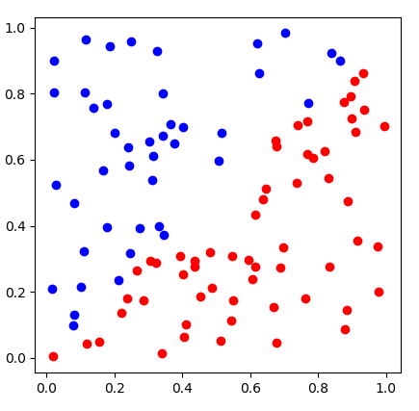
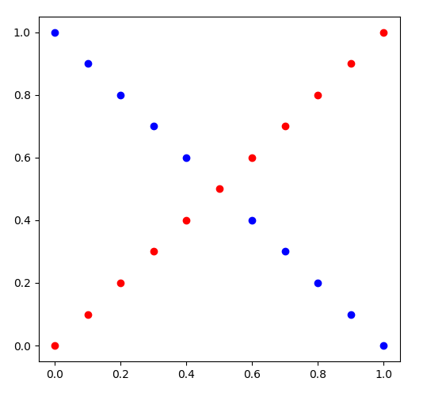
Lab Description - Data
Linear
XOR

Slide 9
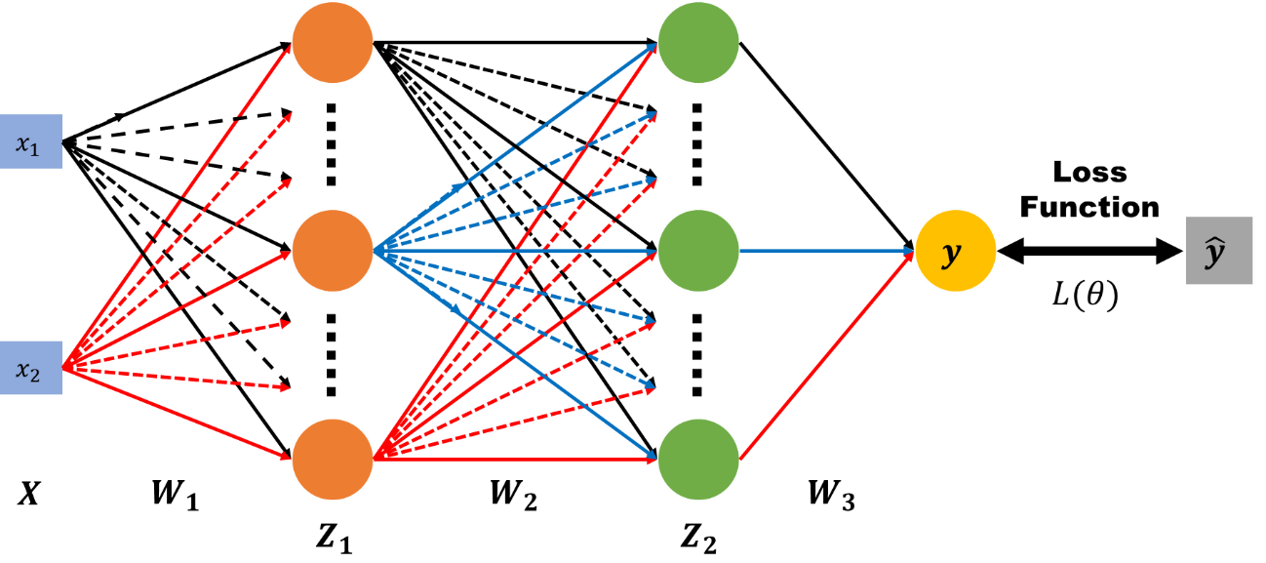



Lab Description – Architecture
$$\left.X :[x_{1}, x_{2}\right]$$
$$y : output$$
$$\hat{y} : ground truth$$
$W_{1}, W_{2}, W_{3}$ $: weight matrix of network layers$

Slide 10
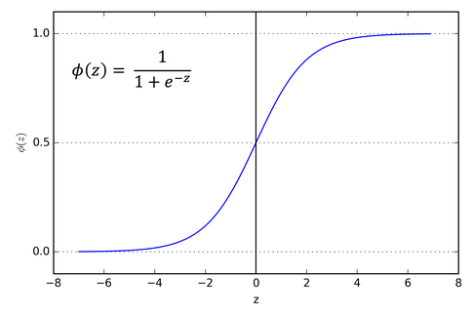
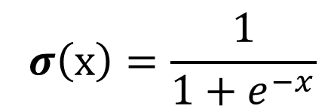
Lab Description – Forward
$Z_{1}=σ(XW_{1})$ $Z_{2}=σ(Z_{1}W_{2})$ $y=σ(Z_{2}W_{3})$
$$σ\left(x\right)=\frac{1}{1+e^{−x}}$$

Slide 11

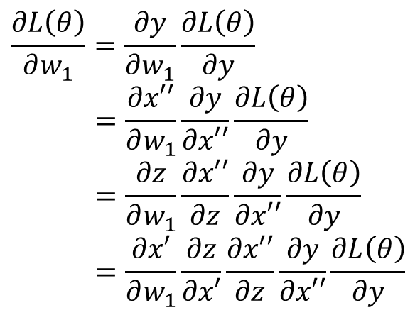






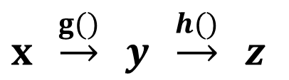




Lab Description – Backward
$$x′$$
$$z$$
$$x′′$$
$$x$$
$$y$$
$$\hat{y}$$
$$w_{1}$$
$${w′}_{1}$$
$$L(θ)$$
$x′=xw_{1}$ $z=σ(x′)$ $x′′=z{w′}_{1}$ $y=σ(x′′)$
$$\frac{∂L\left(θ\right)}{∂w_{1}}=\frac{∂y}{∂w_{1}}\frac{∂L\left(θ\right)}{∂y}$$
$$=\frac{∂x′′}{∂w_{1}}\frac{∂y}{∂x′′}\frac{∂L\left(θ\right)}{∂y}$$
$$=\frac{∂z}{∂w_{1}}\frac{∂x′′}{∂z}\frac{∂y}{∂x′′}\frac{∂L\left(θ\right)}{∂y}$$
$$=\frac{∂x′}{∂w_{1}}\frac{∂z}{∂x′}\frac{∂x′′}{∂z}\frac{∂y}{∂x′′}\frac{∂L\left(θ\right)}{∂y}$$
Chain rule
$y=g\left(x\right) z=h(y)$
$x \underset{→}{g()} y \underset{→}{h()} z$
$$\frac{dz}{dx}=\frac{dz}{dy} \frac{dy}{dx}$$

Slide 12
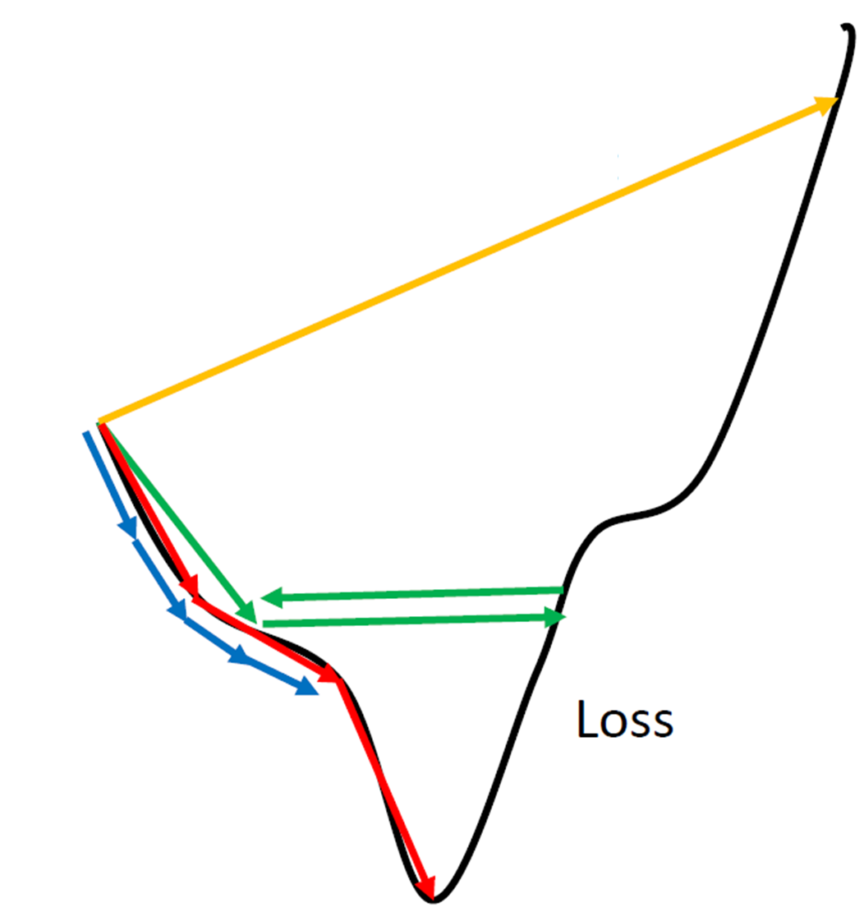










Lab Description – Gradient descent
Network Parameters
$$θ=\{w_{1},w_{2},w_{3},w_{4},⋯\}$$
$$∇L\left(θ\right)=$$
$$\left[\begin{aligned}∂L\left(θ\right)/∂w_{1} \\ ∂L\left(θ\right)/∂w_{2} \\ ∂L\left(θ\right)/∂w_{3} \\ ⋮ \\ ⋮\end{aligned}\right]$$
$${Compute ∇L(θ}^{0})$$
$$θ^{1}={θ^{0} − ρ ∇L(θ}^{0})$$
$$ρ :Learning rate$$
$${Compute ∇L(θ}^{1})$$
$$θ^{2}={θ^{1} − ρ ∇L(θ}^{1})$$
$${Compute ∇L(θ}^{2})$$
$$θ^{3}={θ^{2} − ρ ∇L(θ}^{2})$$
$$⋮$$
http://www.denizyuret.com/2015/03/alec-radfords-animations-for.html

Slide 13
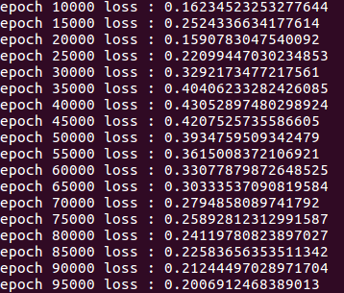
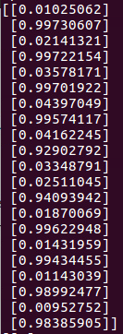
Lab Description - Prediction
In the testing, you need to show your predictions, also the accuracy
In the training, you need to print loss

Slide 14
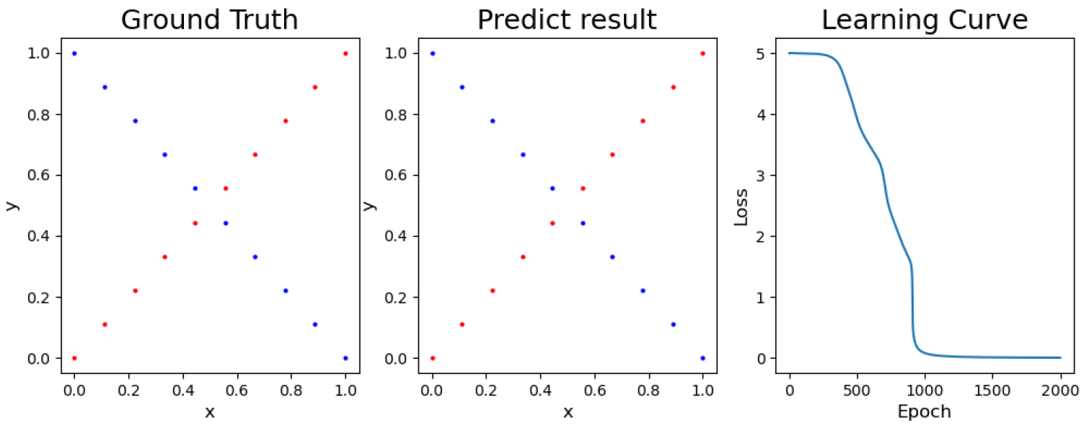
Lab Description - Prediction
Visualize ground truth, your predictions, and learning curve

Slide 15
Scoring Criteria
Report (40%)
Demo (60%)
Experimental results (40%)
Questions (20%)
Late report or demo
Before 8/31

Slide 16
Supplementary Materials

Slide 17
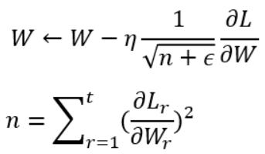
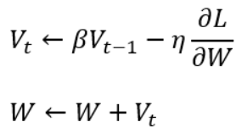
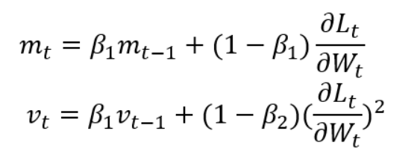
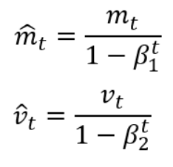
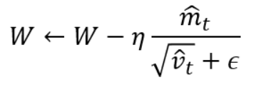
Optimizers
Momentum
AdaGrad
SGD – minibatch
Momentum
AdaGrad
Adam
Adam
https://medium.com/%E9%9B%9E%E9%9B%9E%E8%88%87%E5%85%94%E5%85%94%E7%9A%84%E5%B7%A5%E7%A8%8B%E4%B8%96%E7%95%8C/%E6%A9%9F%E5%99%A8%E5%AD%B8%E7%BF%92ml-note-sgd-momentum-adagrad-adam-optimizer-f20568c968db

Slide 18
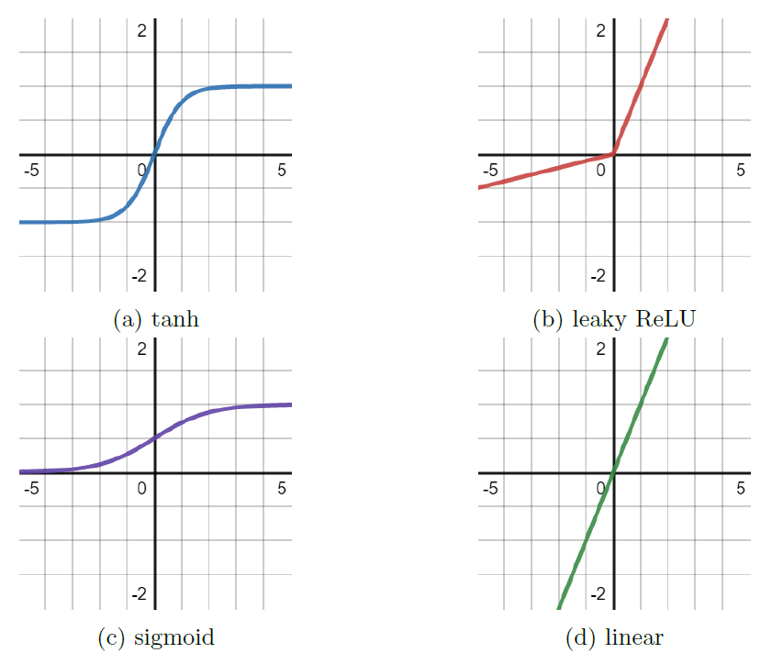
Activation functions
Sigmoid
Tanh
Leaky Relu

Slide 19
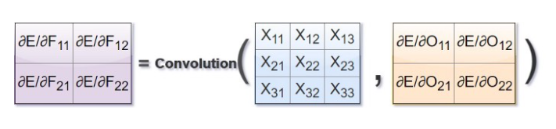
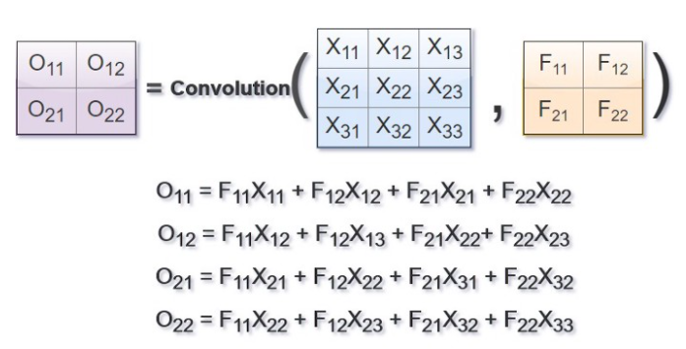
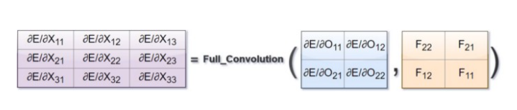
Backpropagation in Convolutional NN
Reference : https://medium.com/@2017csm1006/forward-and-backpropagation-in-convolutional-neural-network-4dfa96d7b37e

Slide 20
Announcement

Slide 21

Machine
Just refer to the installation document

Slide 22
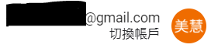
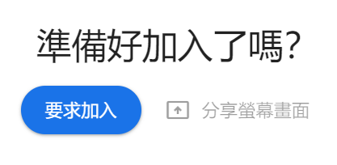
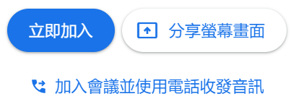
Google Meet
Attend Google Meet using NYCU account
NYCU
Not NYCU

Slide 23
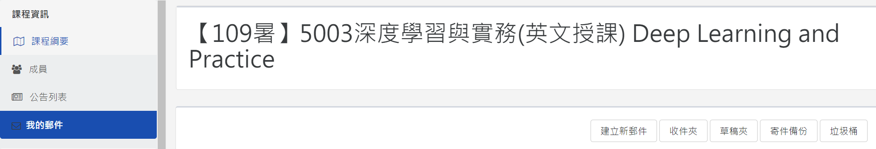
Email via new E3
Use the new e3 email system to send email to me
If you do not use the new e3 email system, I may not reply to you.

